Slide 1
Customer Analytics
Data Wrangling
April 2, 2019

Slide 2
Today’s objective
To cover what it means for data to be tidy and learn how to use tools in the tidyr package that can help you get variables in their own columns, observations in their own rows, and values in their own cells.
Notes:
w/Master - KK

Slide 3
Agenda
Ch 12 run-through
campaign_description
Group project overview
DIY tidy data exercise
Google trends exercise

Slide 4
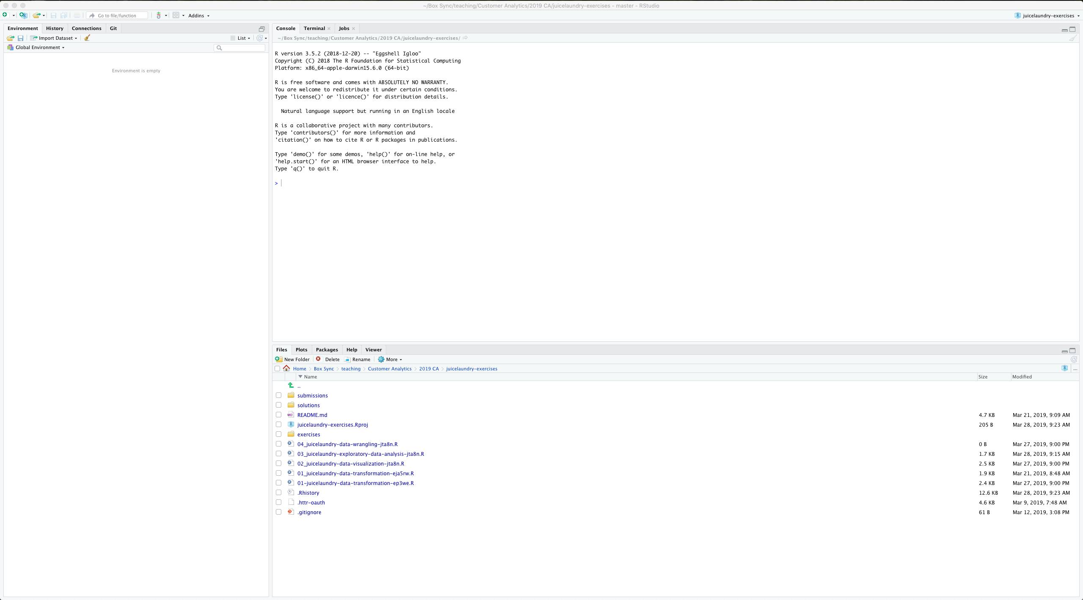

Slide 5

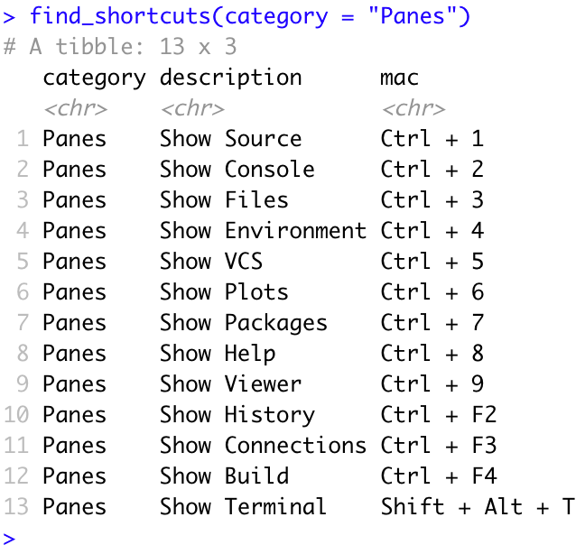
CrossR
Around the 🌎

Slide 6
With concepts from Chapter 12, explain why completejourney::campaign_description needs to be tidied. Then, get as far as you can toward creating the following plot.
Tidy data
Notes:
https://r4ds.had.co.nz/exploratory-data-analysis.html#questions

Slide 7
